Slide 1
Adaptive Data Cleansing with StreamSets and Cassandra
Pat Patterson
Community Champion
@metadaddy
pat@superpat.com

Slide 2
About Pat
Pat Patterson
Community Champion @ StreamSets
Formerly Developer Evangelist at Salesforce
Contact
pat@streamsets.com
@metadaddy

Slide 3
Agenda
Feeding Cassandra with StreamSets Data Collector
User defined aggregate functions in Cassandra
Push statistics back into the data pipeline
Resources
Q & A

Slide 4
Use Case: IoT Sensor Data
Devices sending sensor readings to RabbitMQ via MQTT
Sensor id, time, temperature, orientation
Convert orientation from integer to string
0 -> “horizontal”, 1 -> “vertical”
Filter outlier values
Write ‘clean’ readings to Cassandra

Slide 5
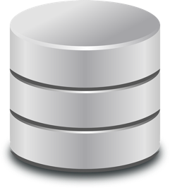




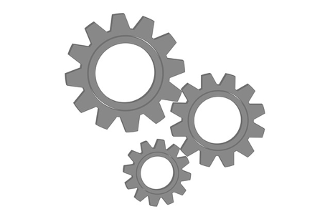





StreamSets Data Collector
http://api
Open source continuous big data ingest infrastructure
Off- or near-cluster
Operating on data in-motion
One-time processing, scales linearly
Direct control over data integrity
Notes:
Pat:
Big data - write once, read many - multiple copies -> multiple transforms
‘t’ is one-time processing - example: area of city lots - consumption readiness
Latency impact - pay cost up front, benefit on every analysis
Arvind:
In-stream transformations especially suited for the likes of PII - get it right once! Doing this multiple times is exponentially more costly.

Slide 6
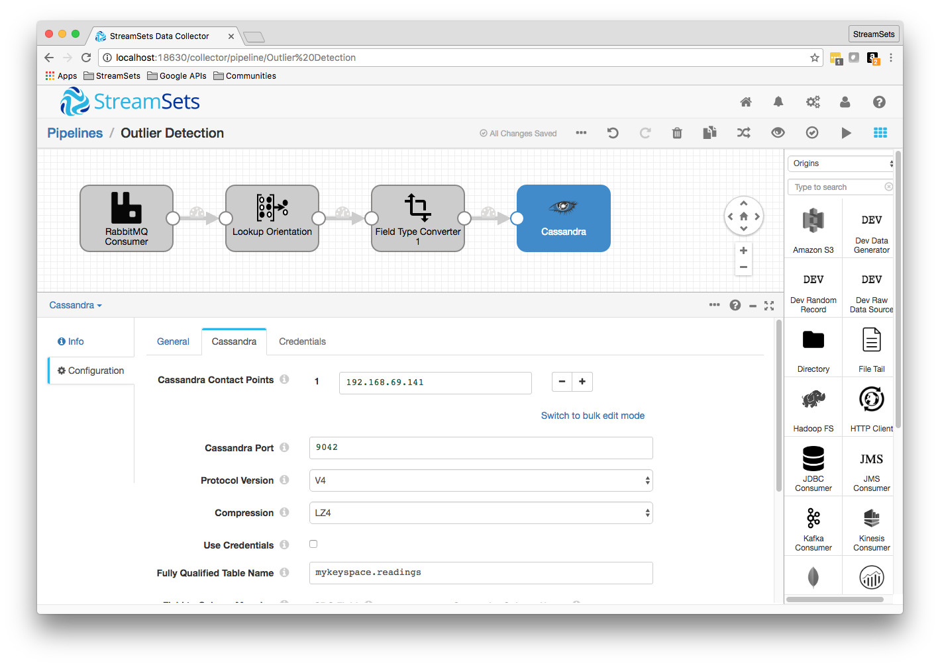
Ingest from RabbitMQ to Cassandra

Slide 7
Cleaning Up The Data
Could easily filter on some static boundary
But that will only catch ‘obvious’ problems
Can we find outlier values in a more dynamic, flexible way?
Let’s define an outlier as any temperature value more than 4 standard deviations from the past hour’s mean temperature

Slide 8
Cassandra User Defined Aggregates
Standard aggregate functions: min, max, avg, sum, count
SELECT avg(temperature), count(temperature) FROM readings WHERE sensor_id = 1 AND time > '2016-08-17 18:11:00+0000'
Define custom aggregates as online algorithms in terms of two Java/JavaScript functions: state function and final function
State function takes old state and value, returns new state
Tuple stateFn(Tuple state, double x)
Final function takes final state, returns aggregate value
double finalFn(Tuple state)

Slide 9
Online Standard Deviation - Welford’s Method
def online_variance(data): n = 0 mean = 0.0 M2 = 0.0 for x in data: n += 1 delta = x – mean mean += delta/n M2 += delta*(x - mean) if n < 2: return float('nan') else: return M2 / (n - 1)

Slide 10
Define Standard Deviation as a UDA
cqlsh:mykeyspace> CREATE OR REPLACE FUNCTION sdState ( state tuple<int,double,double>, val double ) CALLED ON NULL INPUT RETURNS tuple<int,double,double> LANGUAGE java AS 'int n = state.getInt(0); double mean = state.getDouble(1); double m2 = state.getDouble(2); n++; double delta = val - mean; mean += delta / n; m2 += delta * (val - mean); state.setInt(0, n); state.setDouble(1, mean); state.setDouble(2, m2); return state;'; cqlsh:mykeyspace> CREATE OR REPLACE FUNCTION sdFinal ( state tuple<int,double,double> ) CALLED ON NULL INPUT RETURNS double LANGUAGE java AS 'int n = state.getInt(0); double m2 = state.getDouble(2); if (n < 1) { return null; } return Math.sqrt(m2 / (n - 1));'; cqlsh:mykeyspace> CREATE AGGREGATE IF NOT EXISTS stdev ( double ) ... SFUNC sdState STYPE tuple<int,double,double> FINALFUNC sdFinal INITCOND (0,0,0);

Slide 11
Feeding Statistics Back Into the Pipeline
Java app periodically queries Cassandra for mean, standard deviation for the past hour’s data, writes to resource files
PreparedStatement statement = session.prepare( "SELECT AVG(temperature), STDEV(temperature) " + "FROM sensor_readings " + "WHERE sensor_id = ? AND TIME > ?"); BoundStatement boundStatement = new BoundStatement(statement); ... long startMillis = System.currentTimeMillis() - timeRangeMillis; ResultSet results = session.execute( boundStatement.bind(sensorId, new Date(startMillis))); double avg = row.getDouble("system.avg(temperature)"), sd = row.getDouble("mykeyspace.stdev(temperature)");

Slide 12
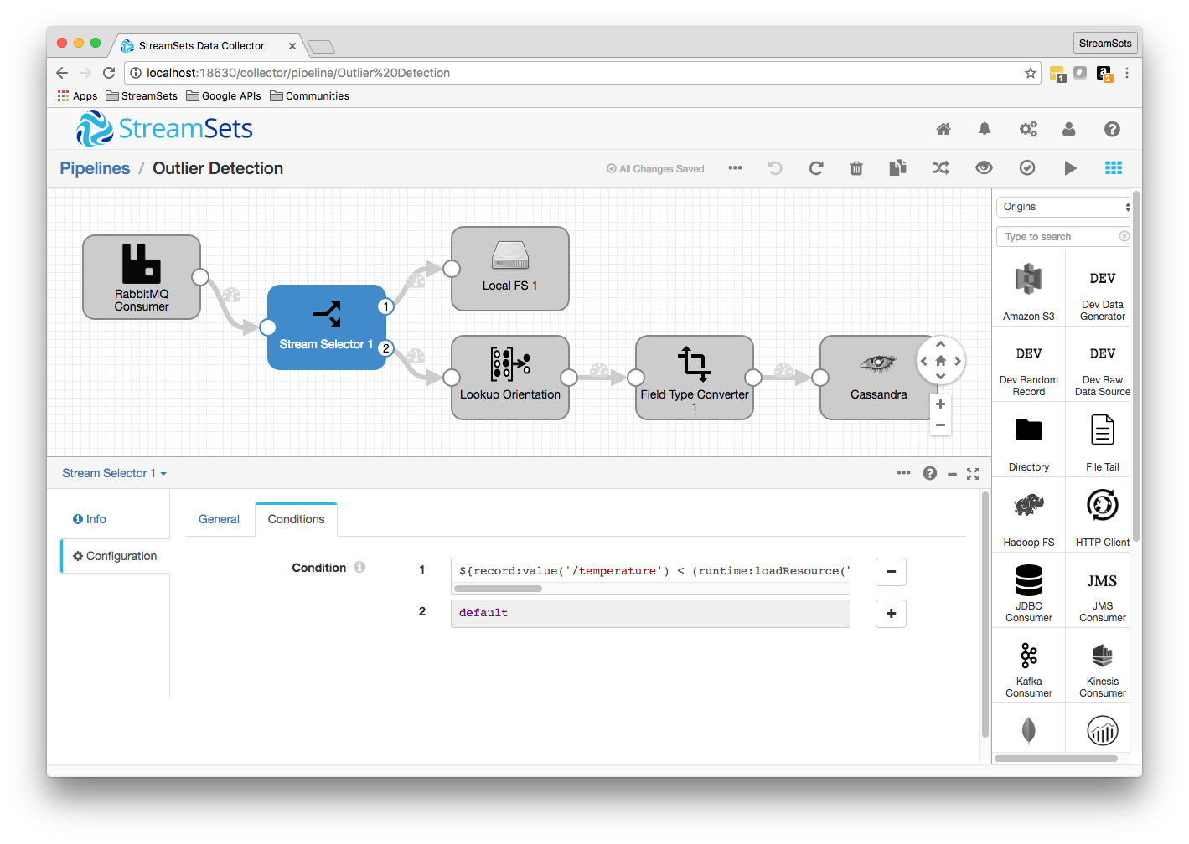
Putting It All Together

Slide 13
Resources
Ingesting MQTT Traffic into Riak TS via RabbitMQ and StreamSets
http://bit.ly/ingest-mqtt
Ingesting Sensor Data on the Raspberry Pi with StreamSets Data Collector
http://bit.ly/ingest-sensors
Standard Deviations on Cassandra – Rolling Your Own Aggregate Function
http://bit.ly/cassandra-uda
Dynamic Outlier Detection with StreamSets and Cassandra
http://bit.ly/dynamic-outliers

Slide 14
Questions?
Pat Patterson
Community Champion
@metadaddy
pat@superpat.com

